Slide 1
Business / Domain Knowledge
Data Acquisition
Data Pre-processing
Feature Selection
Model Selection
What we are solving for
API
Database
Web scrapping
Files
Big Data
4 V’s (Volume, Variety, Veracity, Velocity, Value)
Hadoop
Spark
Crisp DM (methodology)
Pick Algorithm
Model
Validation
Update
Cleaning
Formatting
Feature engineering
Analysis

Slide 2
Machine Learning
Supervised Learning
Unsupervised Learning
Reinforcement Learning
Estimation
Continuous
Classification
Labels
Discrete
Clustering
Dimension Reduction
AI
Predictive Analytics

Slide 3
Supervised Learning
Unsupervised Learning
Linear regression (E)
Logistic Regression (C)
KNN regression (E, C)
Tree (Ensemble) (E, C)
Naïve Bayes (C)
Support Vector Machine (SVM) (C)
Neural Networks (E, C)
Perception
RNN
CMN
Neural network models
Self-organizing map (SOM)
Adaptive resonance theory (ART)
Latent variable models
Expectation–maximization algorithm (EM)
E = Estimation
C = Classification

Slide 4
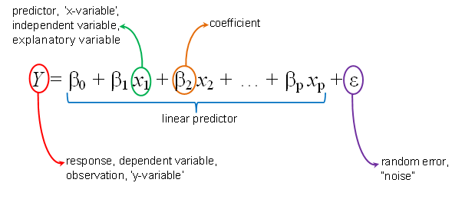
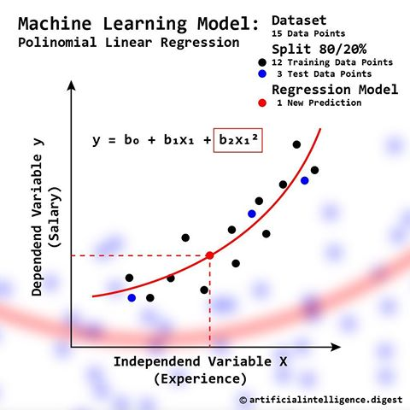
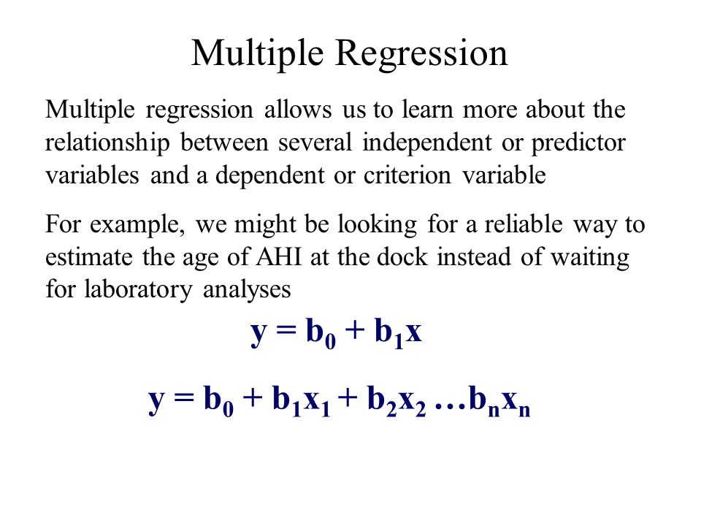

Slide 5
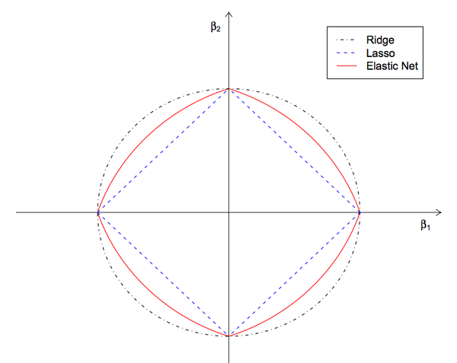
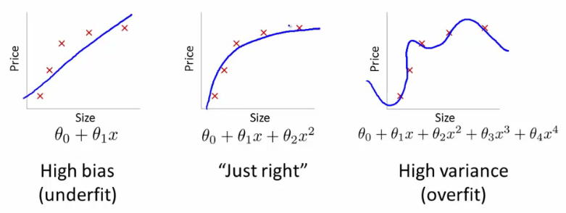
Bias / Variance Dilemma
Regularization
L1
Lasso
L2
Ridge
Ratio
Elastic-Net
Underfit
High bias
Overfit
High variance

